Slide 1

Stroke Prediction Using Machine Learning
A data mining project applying CRISP-DM methodology to predict stroke likelihood from healthcare data.
Team Members: John Baskar Vincent : 033690343
Jaison Felix Menezes. : 033739444
Sakshi Vikas Jadhav : 033702693
Shraddha Jadhav : 033752470
Kalyan Uppalapatti : 033693385

Slide 2




Business Understanding
Objective
Business Application
Predict stroke likelihood in patients using healthcare-related features.
Enable early detection for targeted medical intervention and risk management.
Importance
Stroke is a leading cause of disability and death worldwide.

Slide 3

Dataset Overview
Total Observations
5,110
Attributes
12 (1 target + 11 features)
Source
Kaggle Healthcare Analytics
The dataset contains demographic, medical, and lifestyle features to predict stroke occurrence.

Slide 4
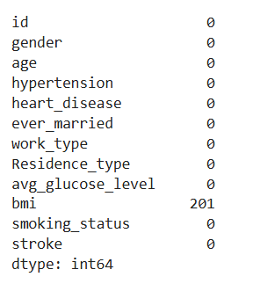
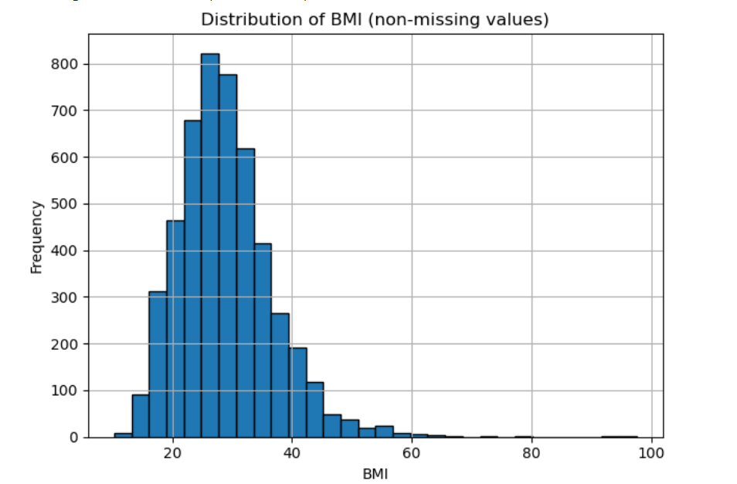
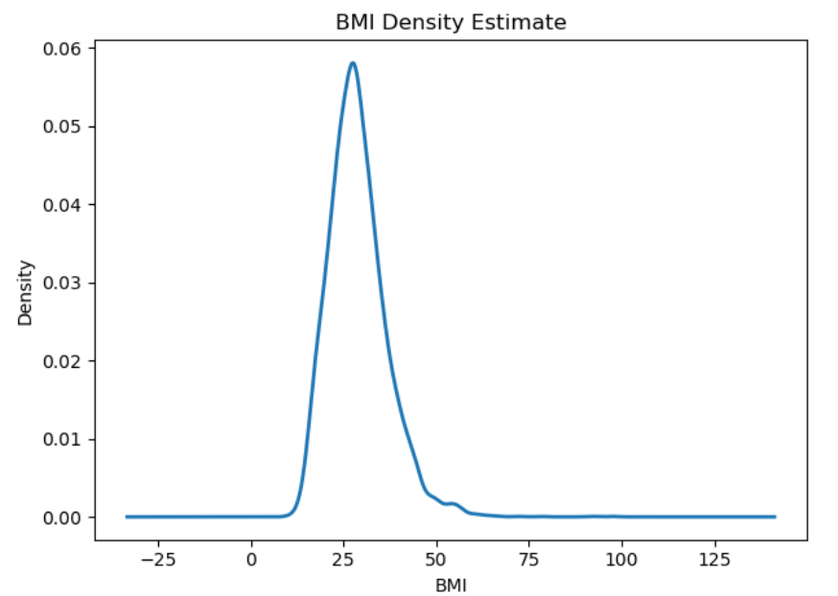
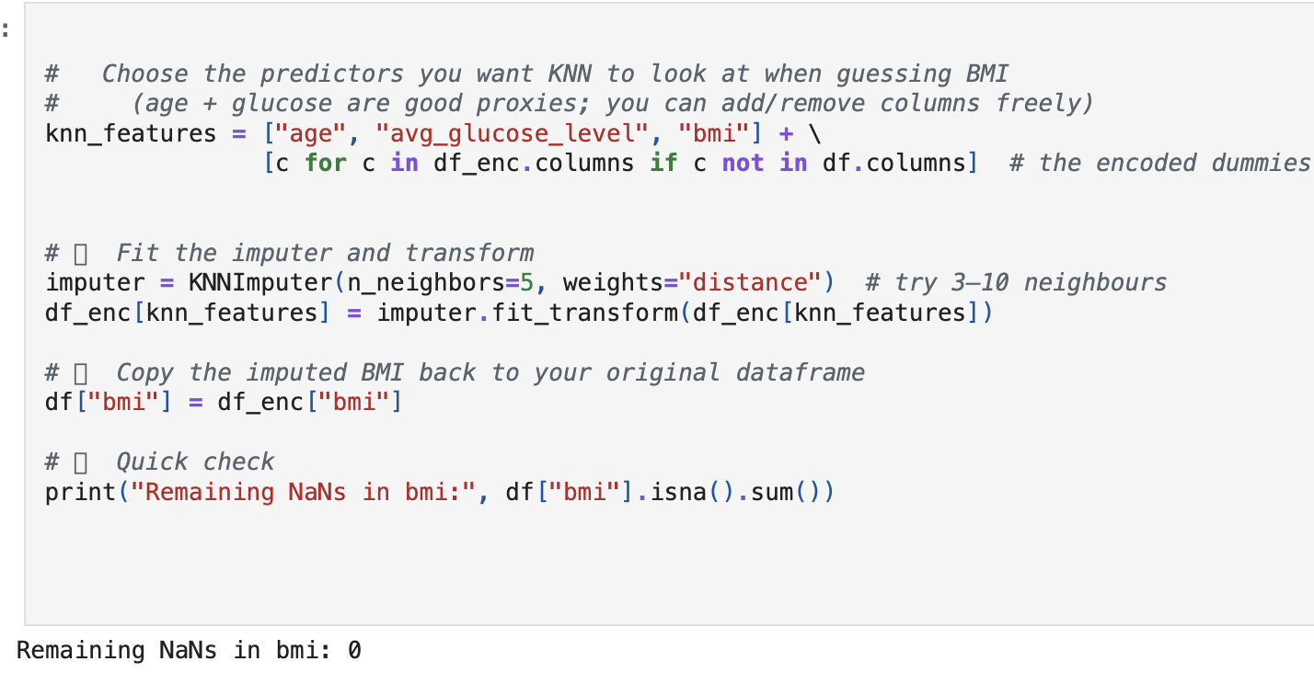
Data Understanding
Missing Values Handling - bmi
Options Considered
Median Imputation: Simple, but ignores relationships between features
KNN Imputation (Chosen):
Handles skewed distribution seen in histogram & density plot
Avoids median’s insensitivity to outliers
Maintains relationships with variables like age and glucose level

Slide 5
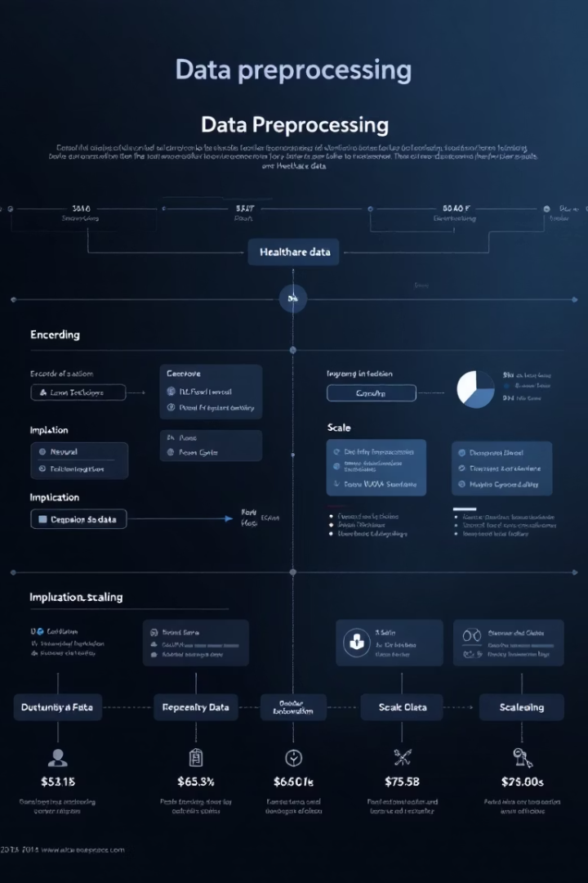
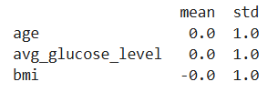
Feature Scaling
⚙️ Why Feature Scaling?
Machine learning models (like KNN, Logistic Regression, SVM) are sensitive to the scale of input features.
Features like age, avg_glucose_level, and bmi are on different scales — which can bias model performance.
⚙️ Method Used: StandardScaler
Transforms data to have mean = 0 and standard deviation = 1
Helps ensure all features contribute equally during distance-based or gradient-based model training
📊 Post-Scaling Summary
✔ Data is now standardized and ready for modeling.

Slide 6
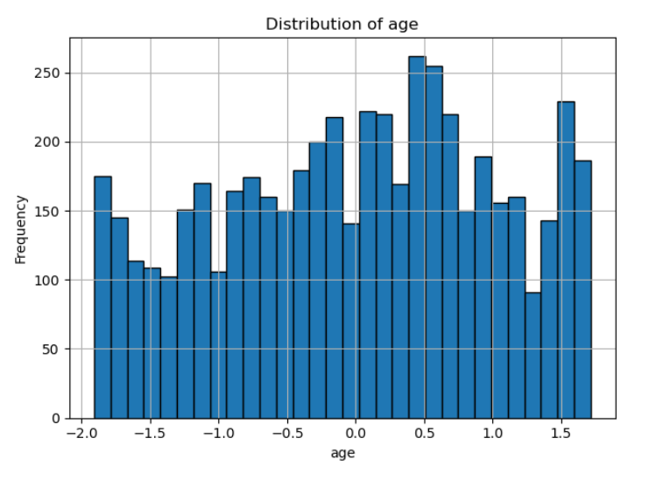
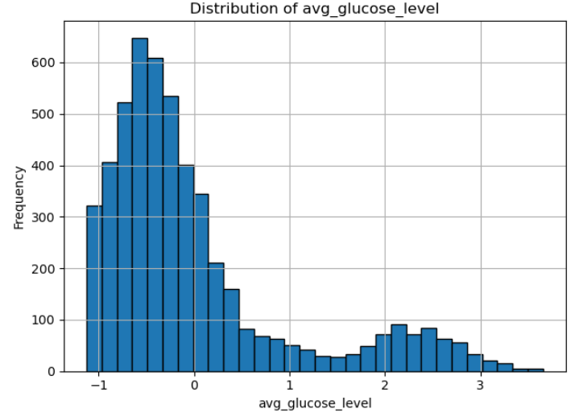
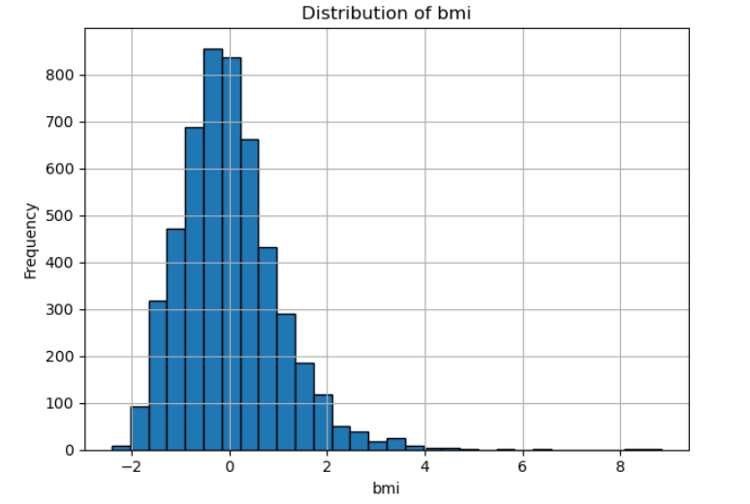
Exploratory Data Analysis
Age Impact
Glucose Level Patterns
BMI Observations
Analyzed distribution and its relation to stroke occurrence
Checked for patterns and stroke association in high glucose ranges
Analyzed central tendency, spread, and presence of outliers
Explored potential trend with stroke risk

Slide 7
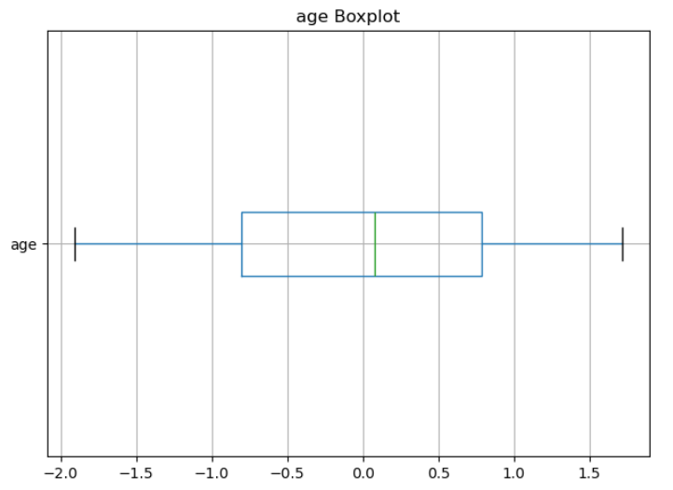
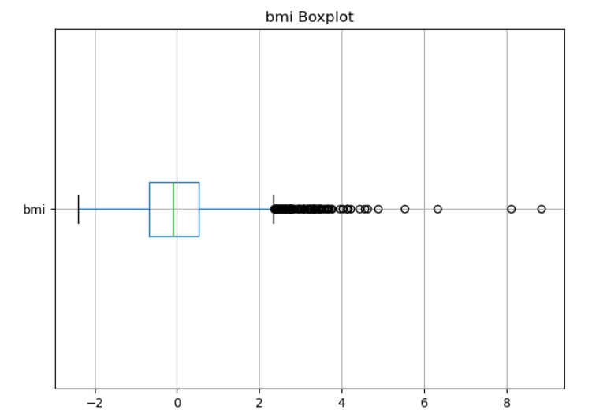
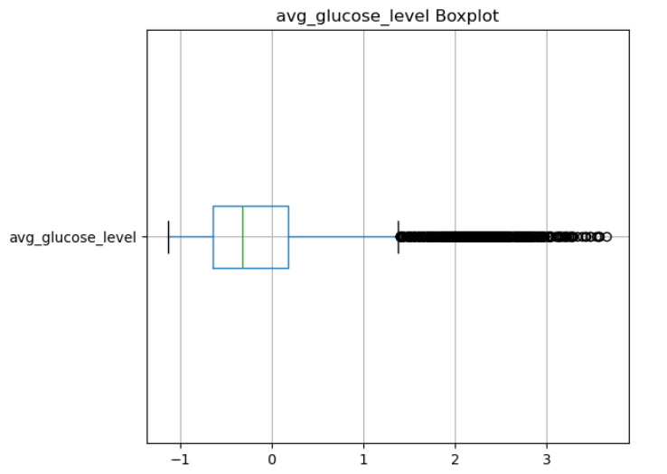
Univariate Feature Spread and Outlier Detection
Age
BMI
Glucose

Slide 8
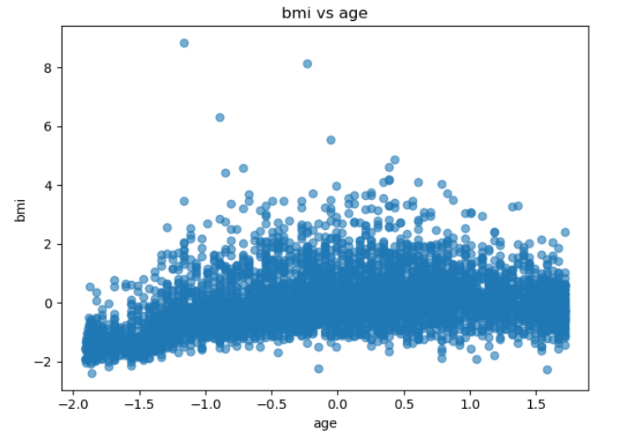
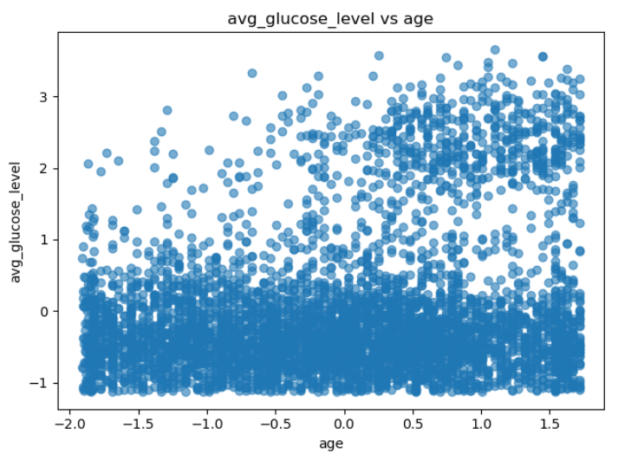
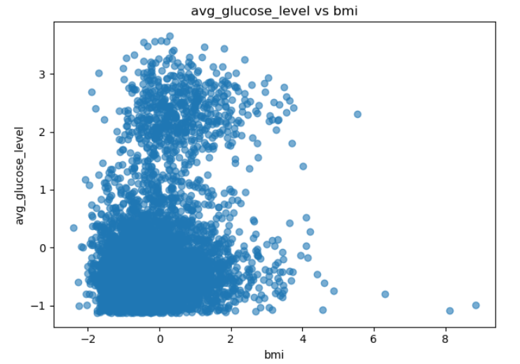
Bivariate Distribution Comparison using Boxplots
BMI vs Age
Glucose vs Age
Glucose vs BMI
Displays a moderately dense distribution with a few higher BMI values across ages. Shows variability of BMI across all age ranges.
Most values cluster below average glucose ~1.0, but higher glucose levels are more frequent in older age groups.
Indicates that higher glucose levels are not strictly correlated with BMI. Some high-glucose cases occur even at lower BMI.

Slide 9
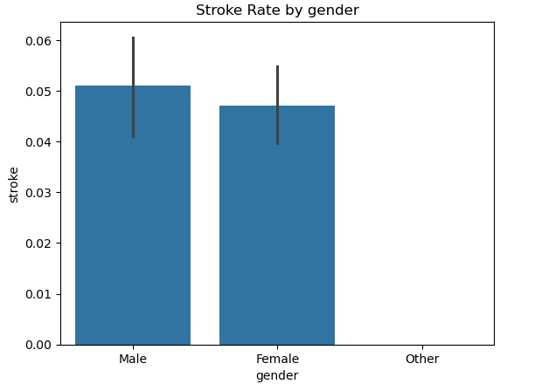
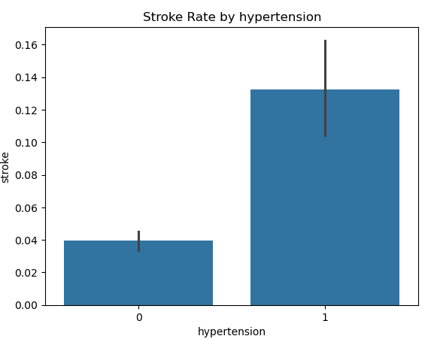
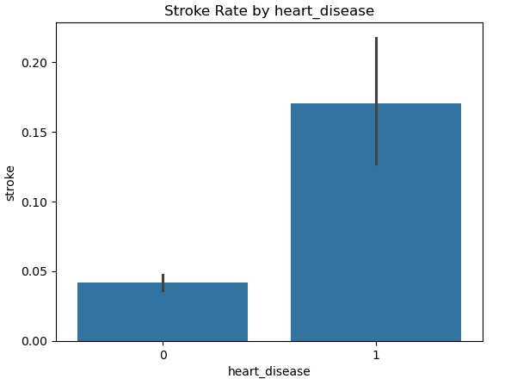
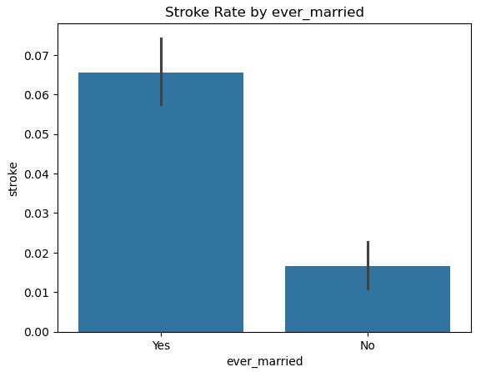
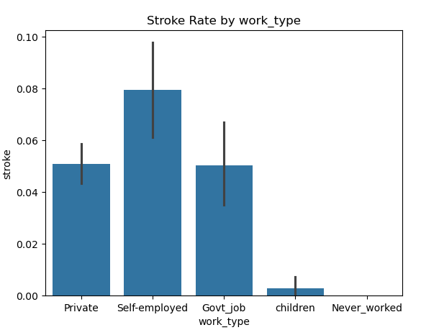
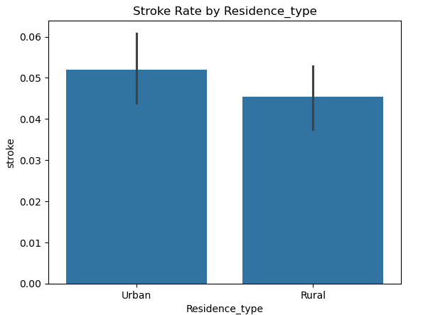
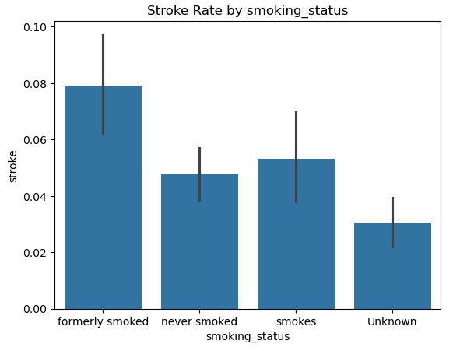
Stroke Rate Across Categorical Variables

Slide 10
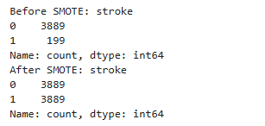
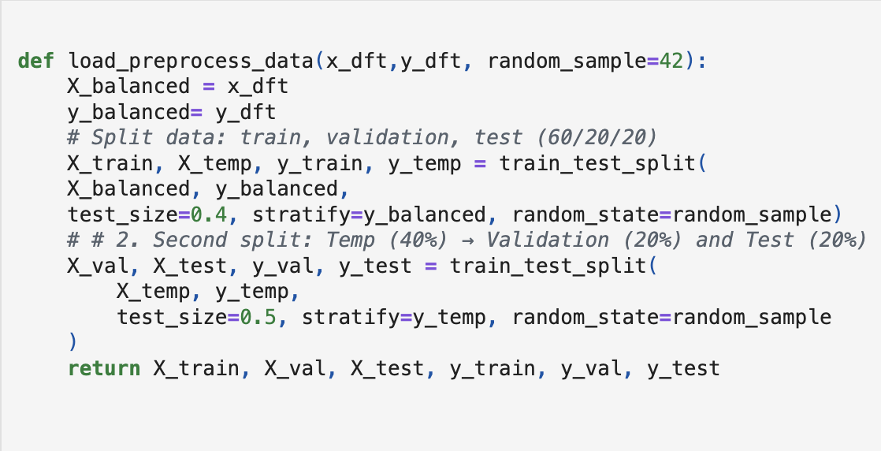
Handling Class Imbalance with SMOTE
The stroke dataset was highly imbalanced
Only 199 positive stroke cases out of 4088 total
Class 1 (stroke) made up less than 5% of the data
This leads to biased models that favor the majority class
Initial Split:
60% Training Set
40% Reserved for Testing + Validation
Split equally into:
20% Validation Set
20% Test Set
💡 Solution: SMOTE (Synthetic Minority Oversampling Technique)
Why SMOTE?
Creates synthetic samples of the minority class based on feature space similarity
Helps balance the dataset without duplication or random noise

Slide 11



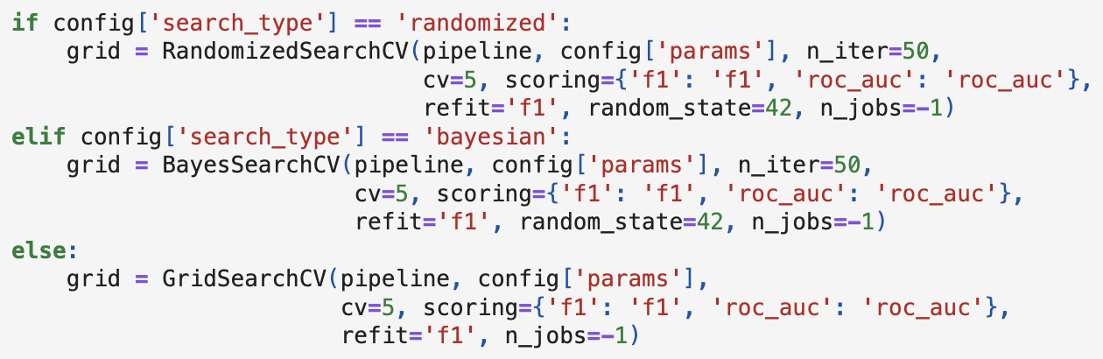

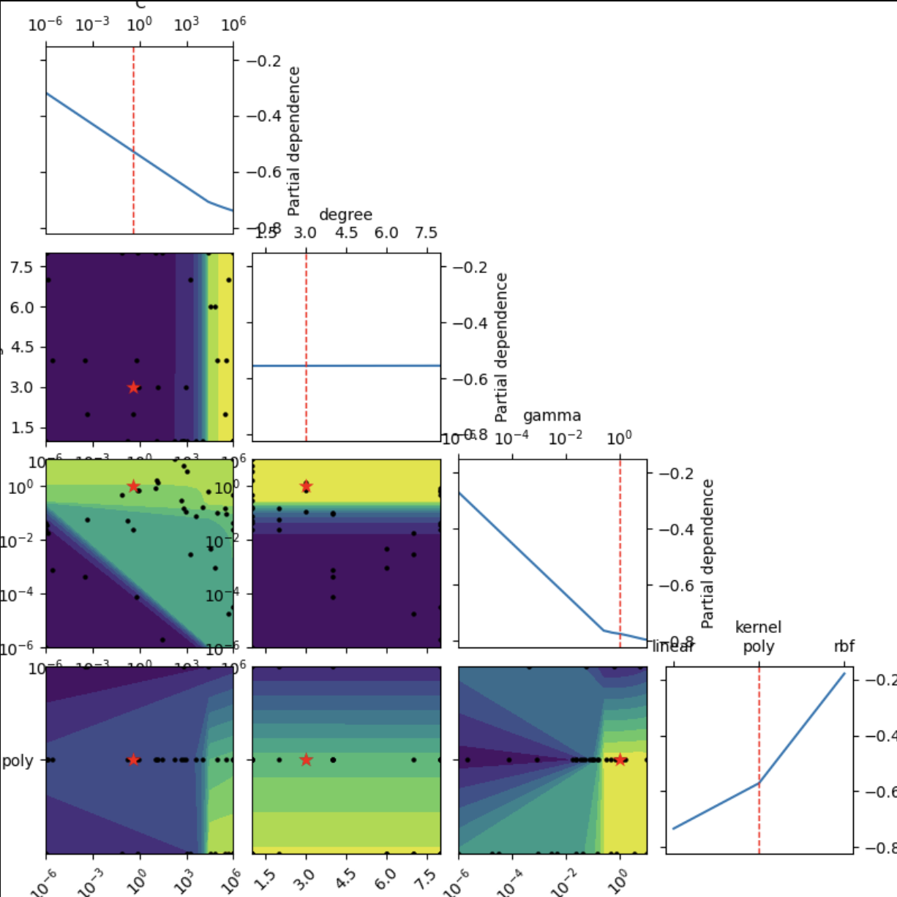
Hyperparameter Tuning
Grid Search
Exhaustive search through parameter spaces for tree depth, regularization strength, and split criteria.
Randomized Search
Efficient sampling of parameter combinations for learning rates and ensemble configurations.
Class Weight Balancing
Adjusted weights inverse to class frequencies to address severe imbalance.
BayesSearchCV
Optimimizes hyerparamaters by learning from past results to guide future searches..
4o

Slide 12
Models
Logistic Regression
Random
XG boost
LightGBM
Decision Tree

Slide 13
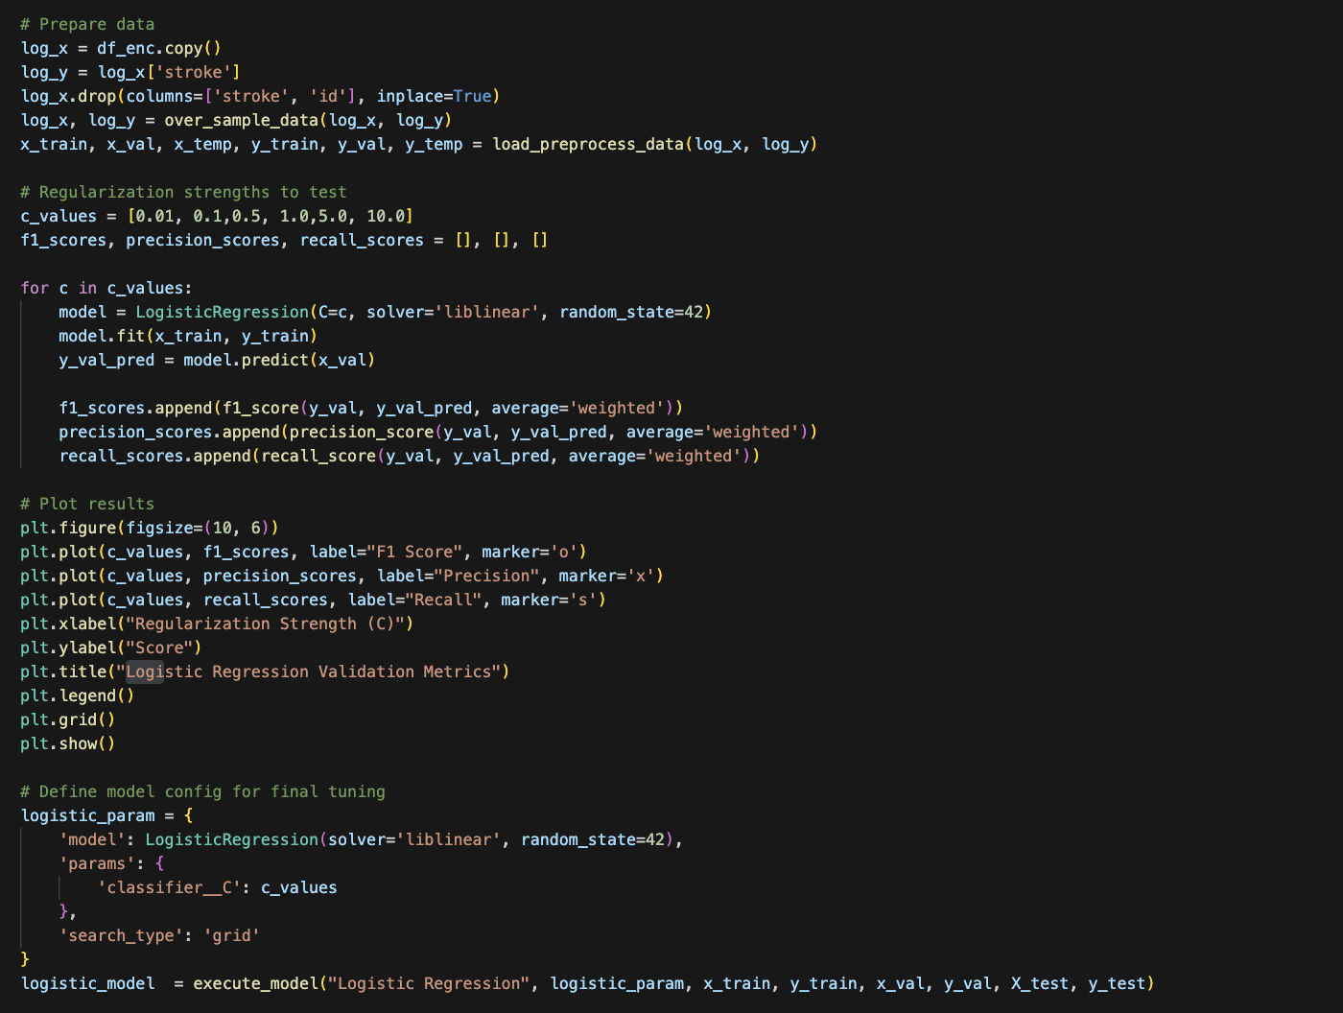
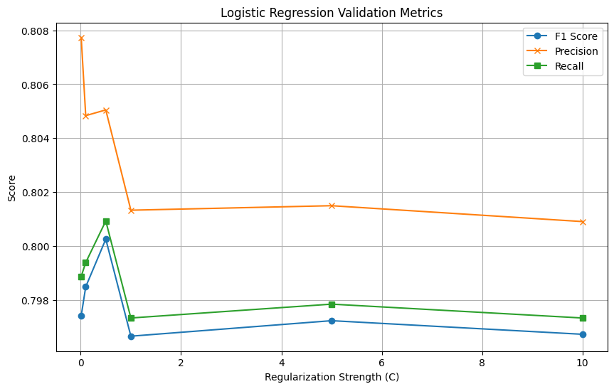
• A statistical model that predicts the probability of a binary outcome using a logistic function. • Ideal for quick, interpretable baseline models in stroke prediction tasks.
Logistic Regression

Slide 14
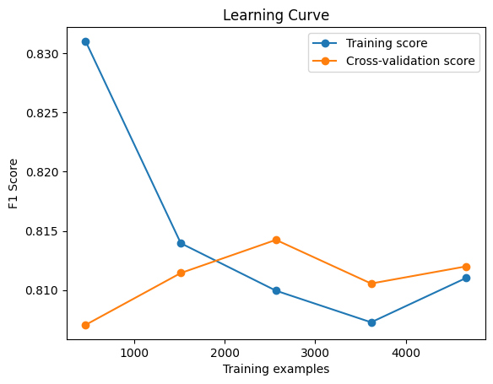
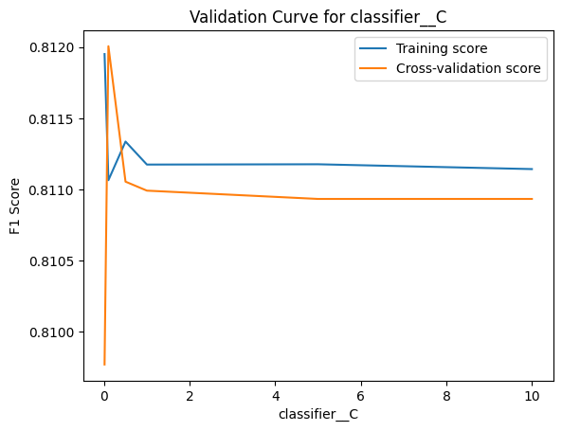
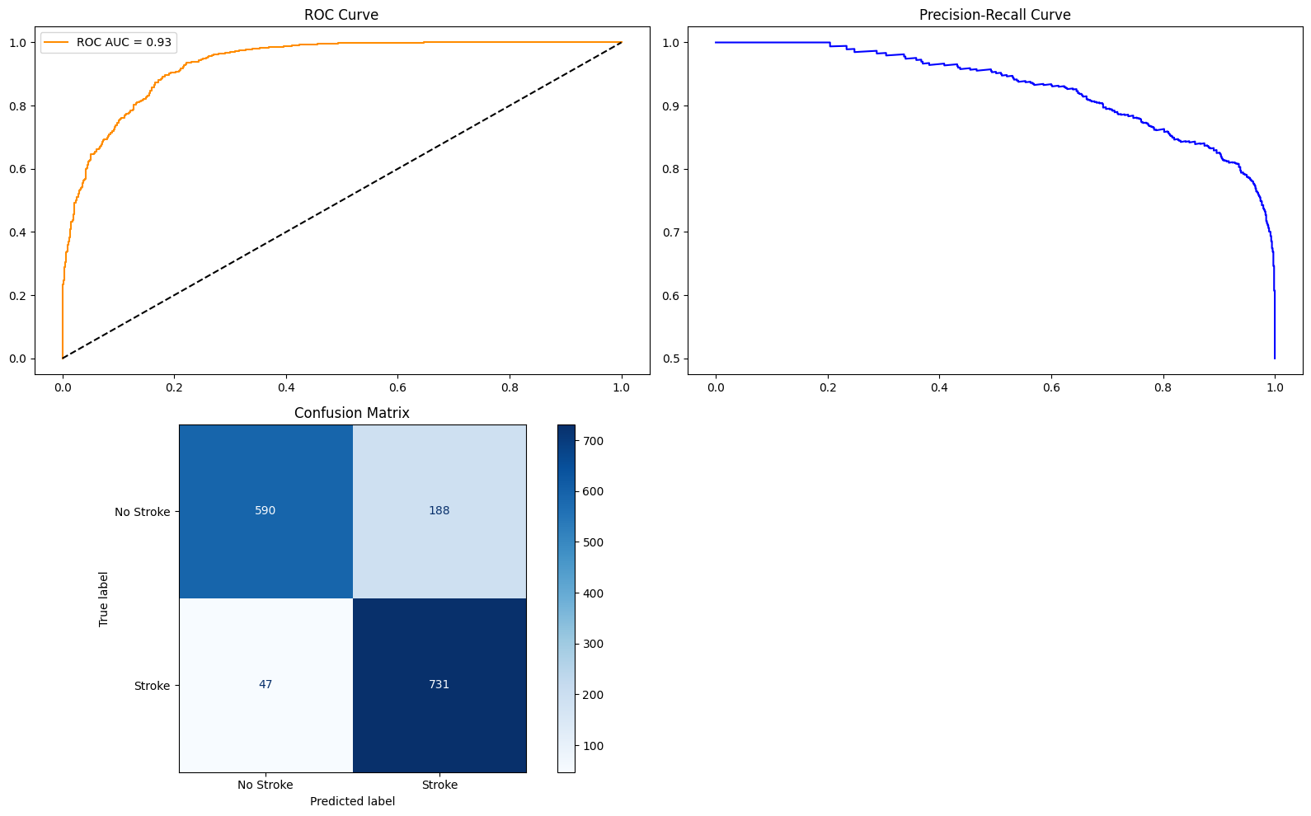
Logistic Regression

Slide 15
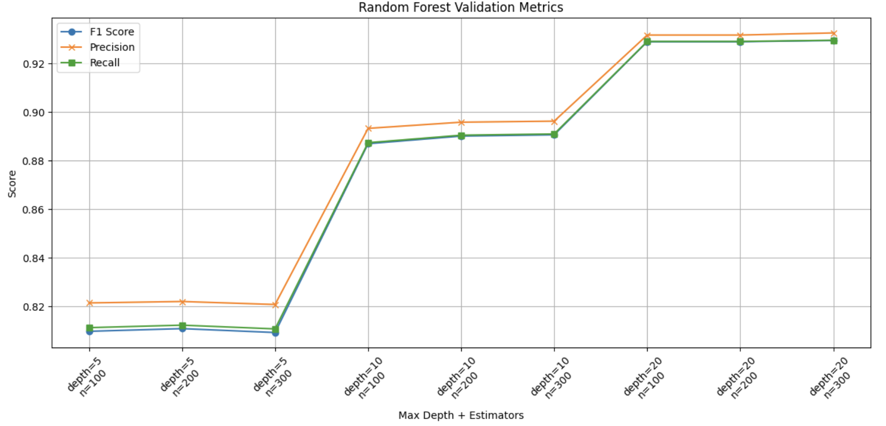
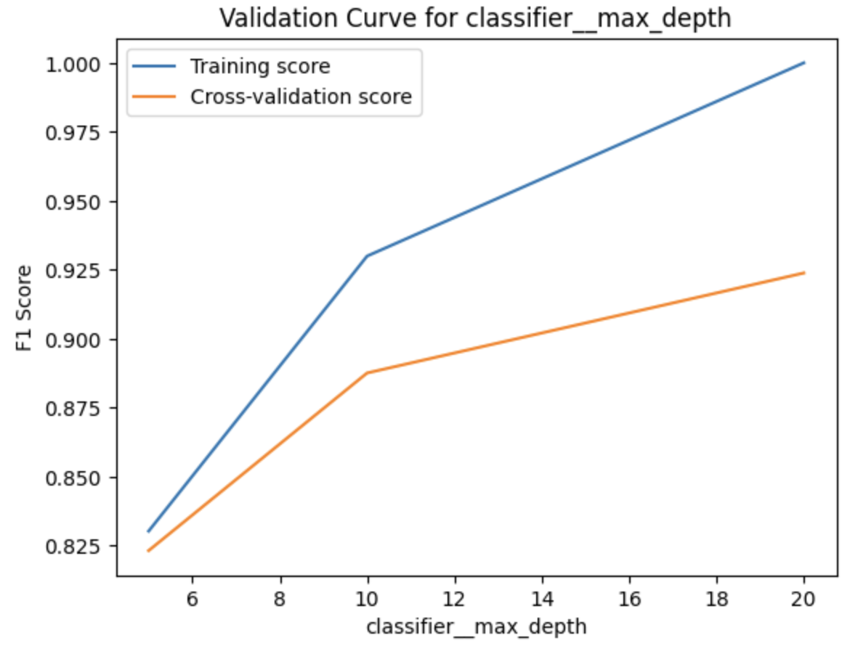
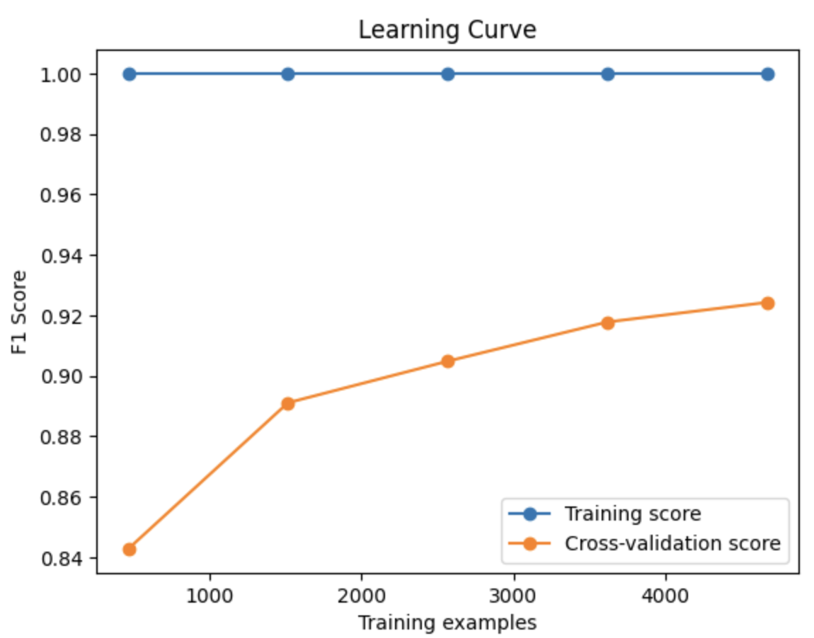
Random Forest
Ensemble of Decision Trees: Improves prediction accuracy and robustness by combining multiple decision trees.
Reduces Overfitting: Generalizes well on unseen health data, making it reliable for medical predictions.
Provides Feature Importance: Helps identify the most critical health factors contributing to stroke risk.

Slide 16
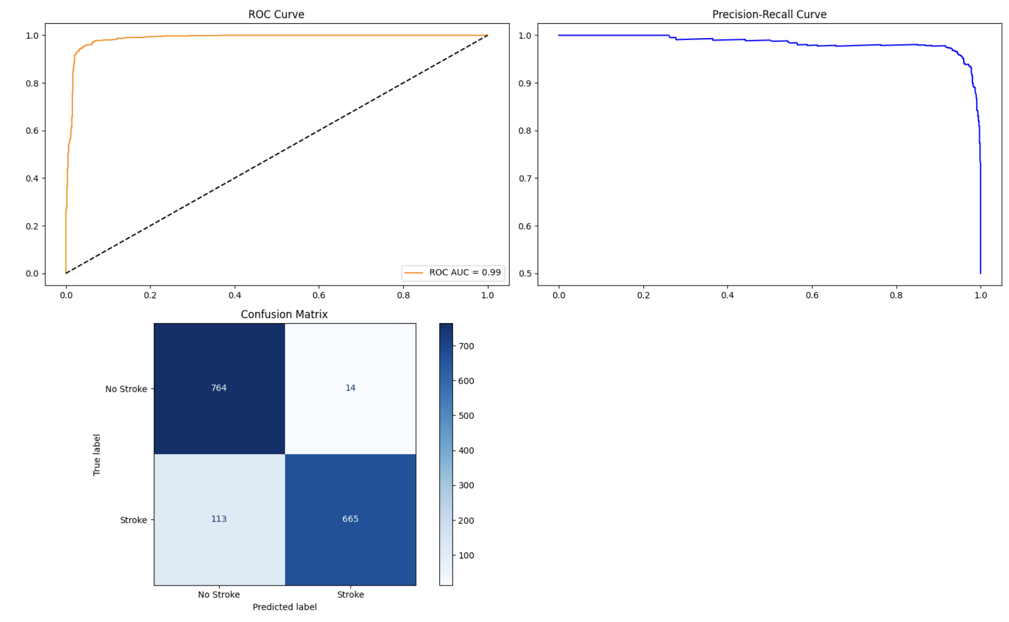
Random Forest

Slide 17
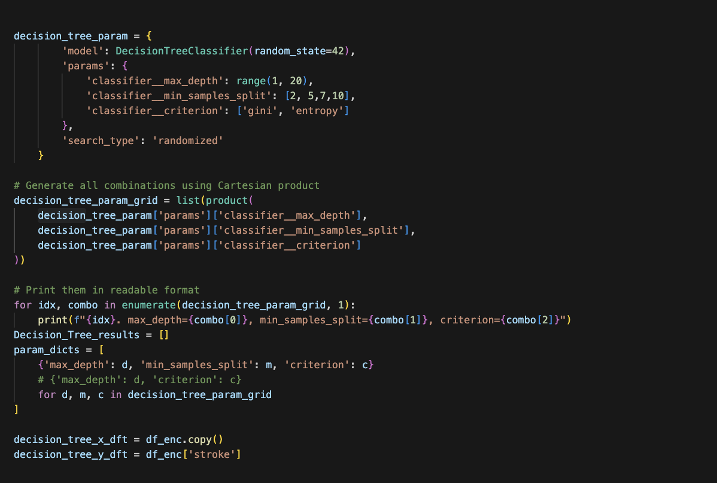
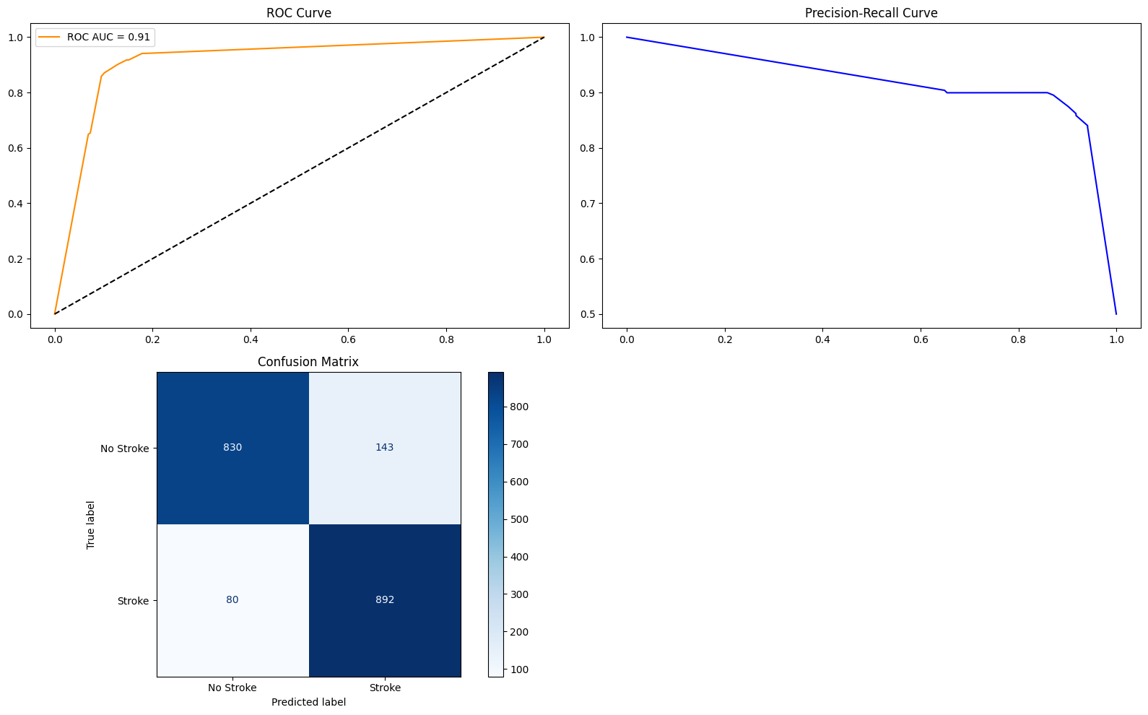
Decision Tree Classifier
Captures Non-Linear Relationships: Effectively models complex interactions between health indicators (like age, BMI, and glucose) without requiring data transformation.
Interpretable Results: Provides clear decision rules, making it easy for healthcare professionals to understand how risk predictions are made.
Handles Missing & Categorical Data Well: Robust to missing values and categorical variables, which are common in medical datasets.

Slide 18
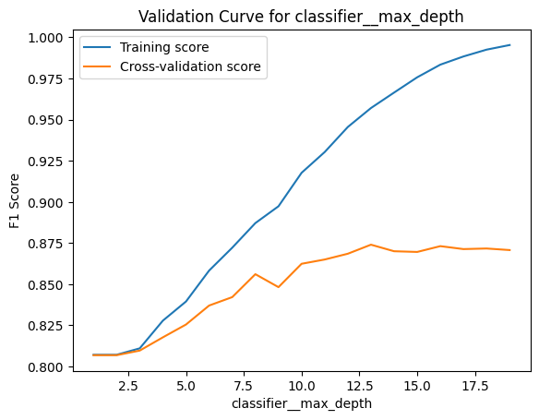
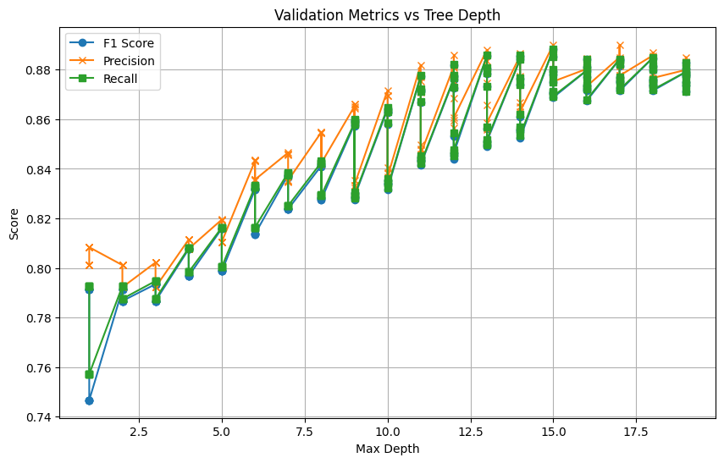
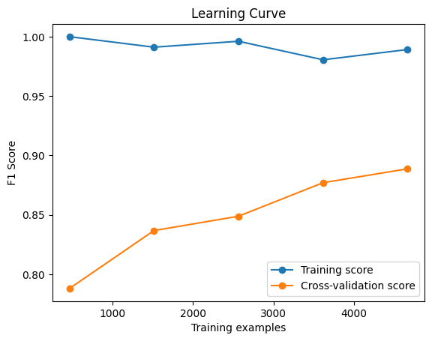
Decision Tree Classifier

Slide 19
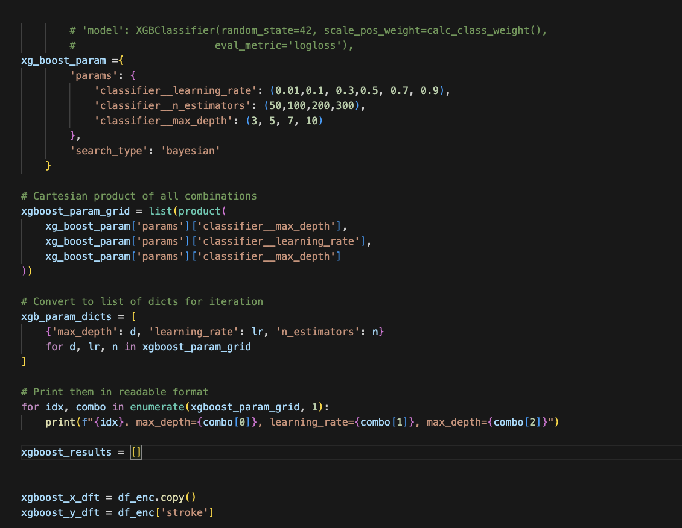
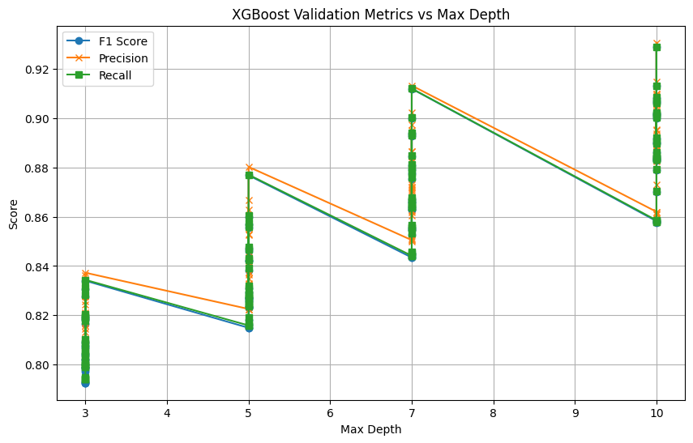
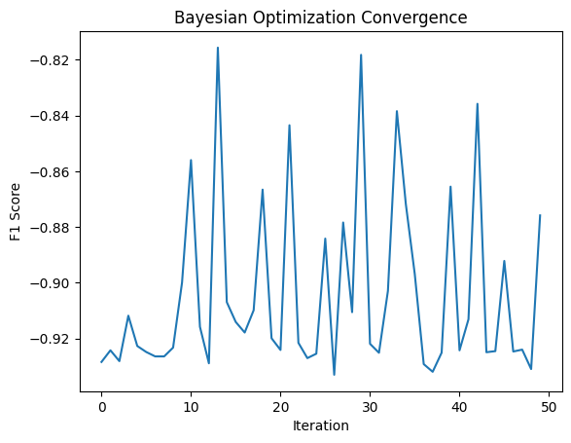
High Accuracy & Speed: Efficiently handles large, imbalanced datasets and delivers top performance in terms of prediction accuracy.
Built-in Handling of Missing Data: Automatically manages missing values, which is valuable when dealing with incomplete medical records.
Feature Importance Insights: Highlights the most influential health factors (e.g., age, hypertension), aiding in clinical interpretation.
XGBoost Classifier

Slide 20
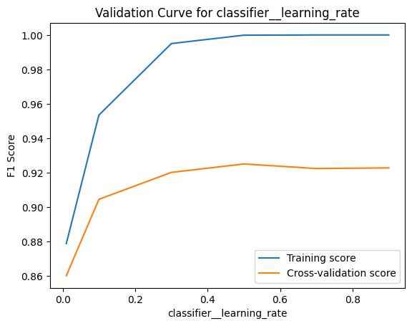
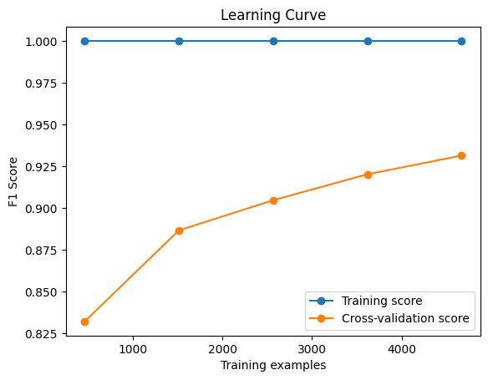
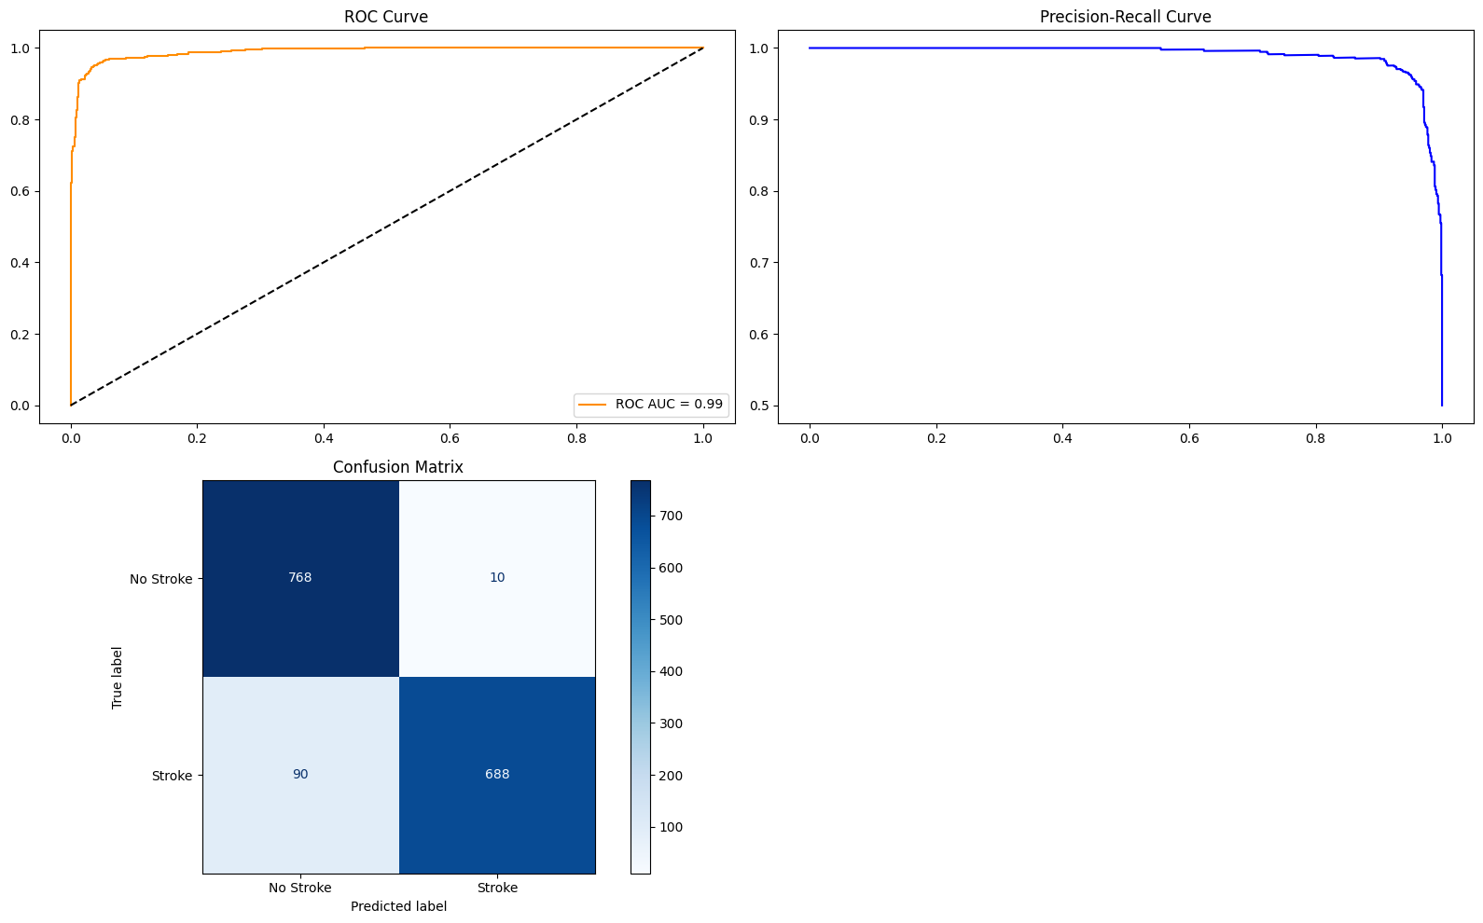
XGBoost Classifier

Slide 21
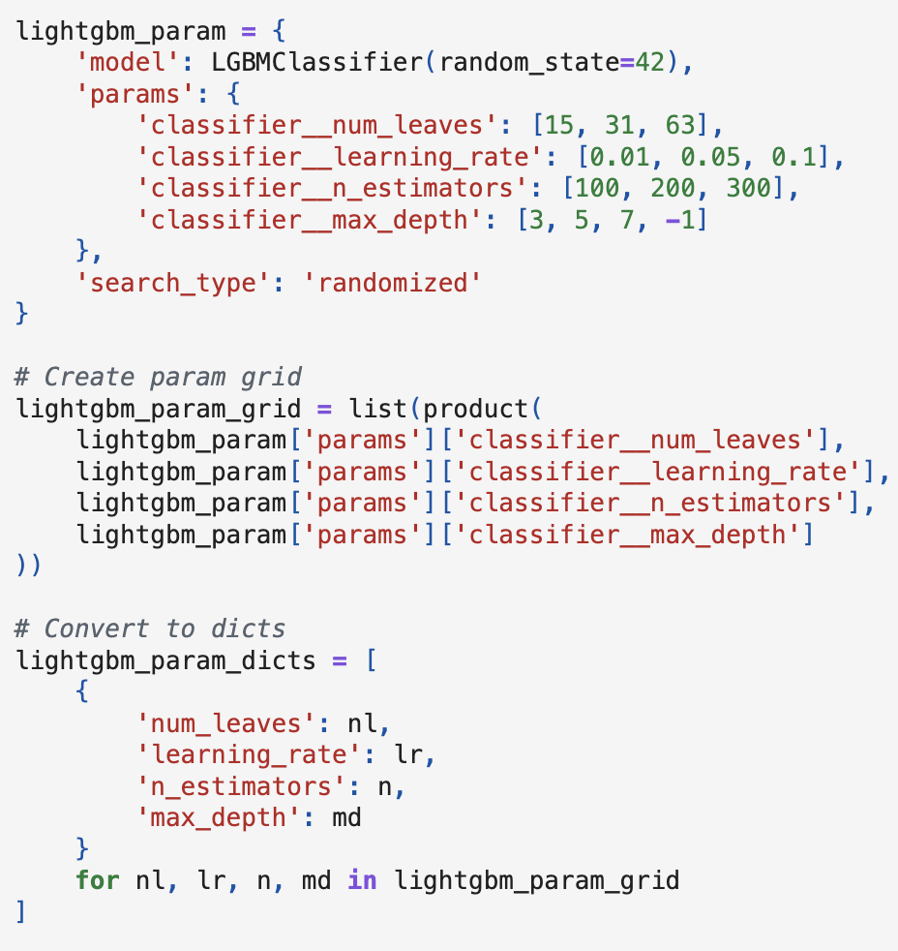
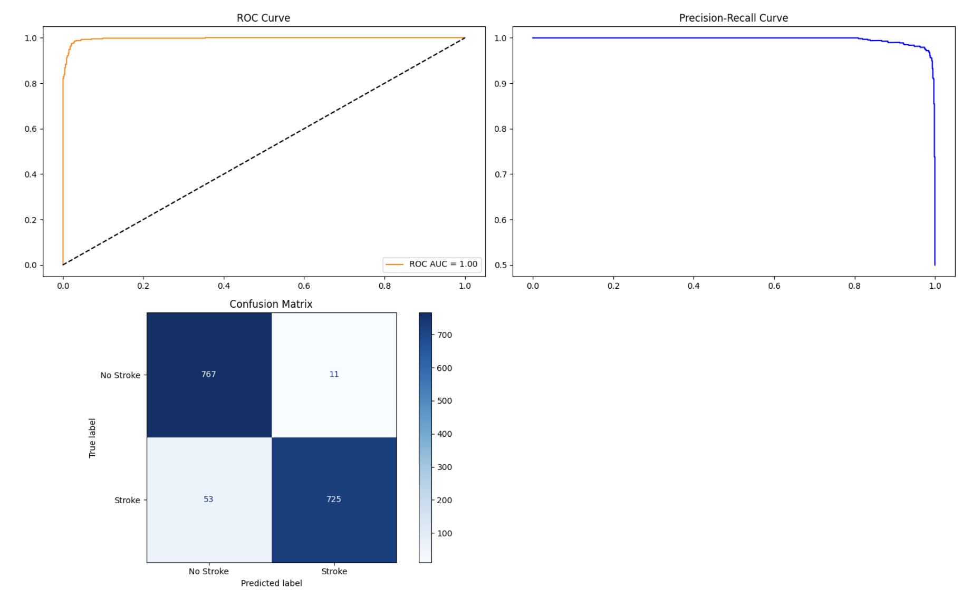
LightGBM
Fast and Scalable: Trains much faster than traditional gradient boosting models, ideal for large healthcare datasets.
High Accuracy with Low Memory Usage: Efficiently handles imbalanced data and delivers top-tier prediction performance.
Supports Categorical Features Natively: Reduces preprocessing needs and preserves data integrity.

Slide 22
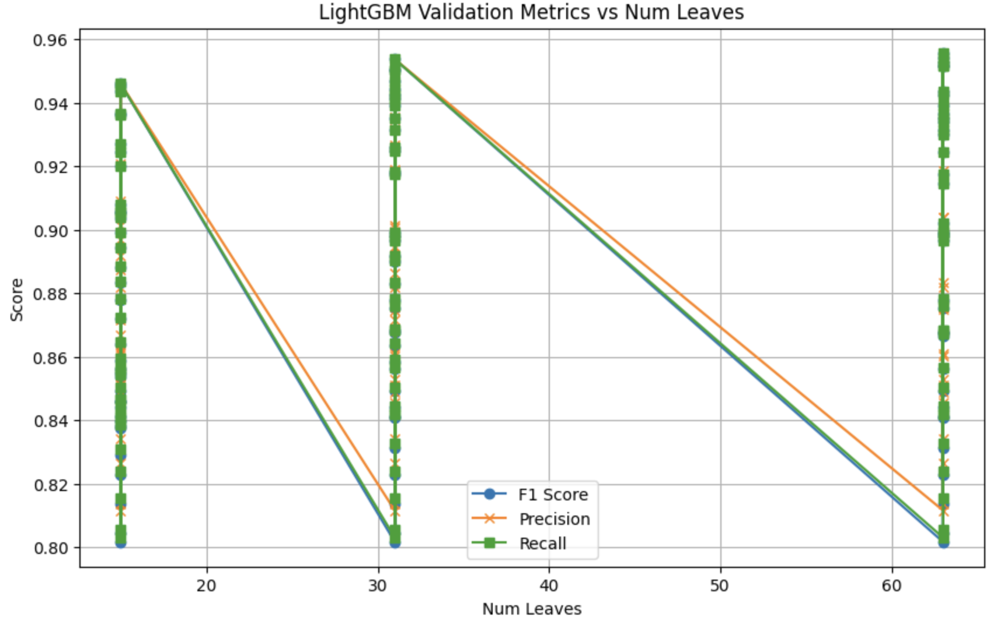
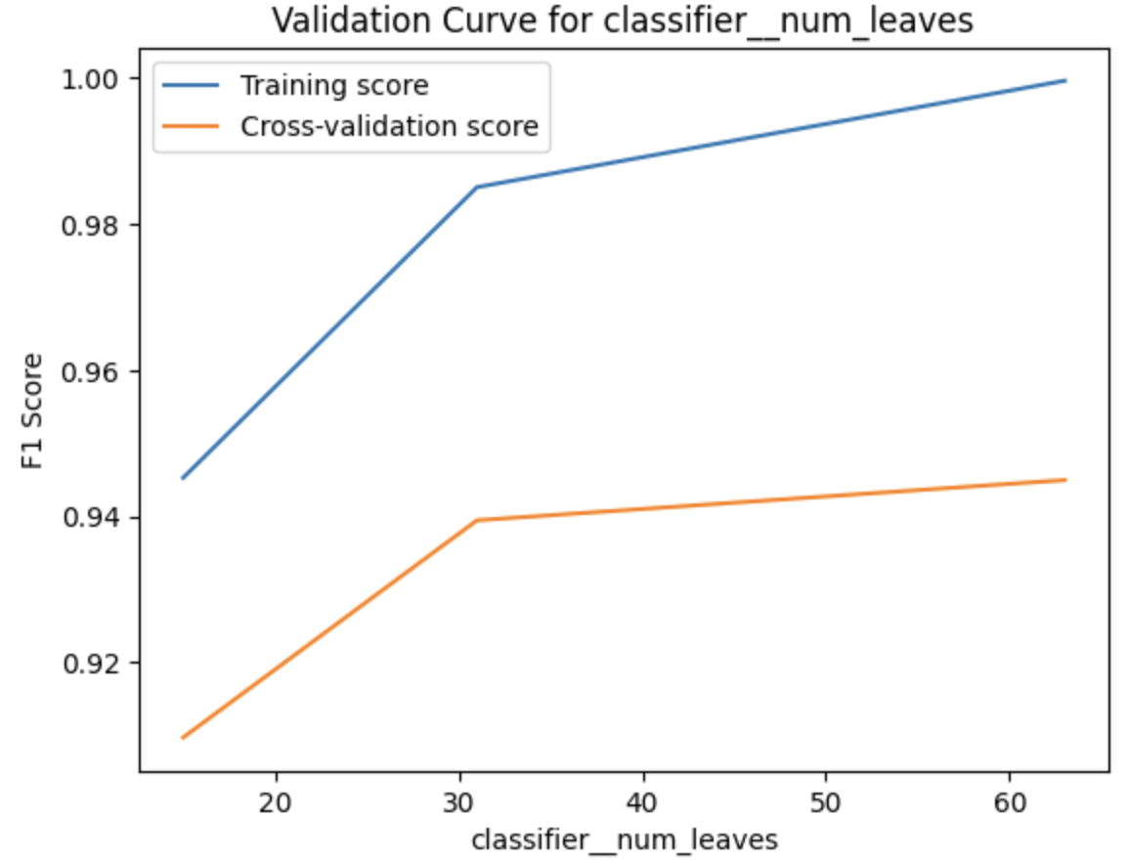

LightGBM

Slide 23
LightGBM

Slide 24
Model Comparison
Model | F1 (Test) | F1 (Val) | ROC AUC (Test) | ROC AUC (Val) | Accuracy (Test) | Precision | Recall | Confusion Matrix | Best Params | F1 Gap
LightGBM | 0.95883891 | 0.95678994 | 0.996766807 | 0.993012159 | 0.956790123 | 0.9602101 | 0.95886889 | [[767, 11], [53, 725]] | {'classifier__num_leaves': 63, 'classifier__n_estimators': 300, 'classifier__max_depth': -1, 'classifier__learning_rate': 0.1} | 0.002048965
CatBoost | 0.94851458 | 0.95367546 | 0.992603472 | 0.992183399 | 0.953703704 | 0.95109317 | 0.94858612 | [[767, 11], [69, 709]] | {'classifier__learning_rate': 0.1, 'classifier__iterations': 500, 'classifier__depth': 10} | -0.005160878
XGBoost | 0.93556231 | 0.93721063 | 0.989565229 | 0.987499788 | 0.937242798 | 0.94038912 | 0.93573265 | [[768, 10], [90, 688]] | OrderedDict([('classifier__learning_rate', 0.3), ('classifier__max_depth', 10), ('classifier__n_estimators', 200)]) | -0.001648318
Random Forest | 0.91804872 | 0.92890368 | 0.986797107 | 0.983707916 | 0.929012346 | 0.92526655 | 0.91838046 | [[764, 14], [113, 665]] | {'classifier__max_depth': 20, 'classifier__n_estimators': 200} | -0.010854967
Balanced RF | 0.90893616 | 0.92580648 | 0.986360122 | 0.985097123 | 0.925925926 | 0.91757962 | 0.90938303 | [[762, 16], [125, 653]] | {'classifier__n_estimators': 300, 'classifier__max_samples': 0.5, 'classifier__max_features': 0.5, 'classifier__max_depth': 20} | -0.016870317
Bagging | 0.90103225 | 0.93359262 | 0.98522677 | 0.986668381 | 0.933641975 | 0.91231458 | 0.90167095 | [[764, 14], [139, 639]] | {'classifier__n_estimators': 300} | -0.032560361
KNN | 0.90001289 | 0.9047204 | 0.951018861 | 0.946001414 | 0.905349794 | 0.90644586 | 0.9003856 | [[748, 30], [125, 653]] | OrderedDict([('classifier__metric', 'manhattan'), ('classifier__n_neighbors', 3), ('classifier__weights', 'distance')]) | -0.004707508
Decision_tree | 0.88522854 | 0.87771596 | 0.91452235 | 0.905293697 | 0.87808642 | 0.88697475 | 0.88534704 | [[830, 143], [80, 892]] | {'classifier__min_samples_split': 2, 'classifier__max_depth': 19, 'classifier__criterion': 'entropy'} | 0.007512587
Boosting | 0.86570065 | 0.83241873 | 0.95061657 | 0.919296368 | 0.83281893 | 0.87325267 | 0.86632391 | [[621, 157], [51, 727]] | {'classifier__n_estimators': 200} | 0.033281924
SVM | 0.8585361 | 0.87433893 | 0.938334732 | 0.942095759 | 0.875 | 0.85938131 | 0.85861183 | [[650, 128], [92, 686]] | {'classifier__kernel': 'rbf', 'classifier__gamma': 'scale', 'classifier__C': 10} | -0.01580283
Logistic Regression | 0.8477213 | 0.79772962 | 0.932621711 | 0.880826729 | 0.798353909 | 0.86082323 | 0.84897172 | [[590, 188], [47, 731]] | {'classifier__C': 0.1} | 0.049991678
Naive Bayes | 0.82657068 | 0.79768653 | 0.91784022 | 0.864293849 | 0.799382716 | 0.8489963 | 0.82904884 | [[552, 226], [40, 738]] | {'classifier__alpha': 0.1} | 0.028884149
Gaussian NB | 0.56064026 | 0.55805062 | 0.904090477 | 0.853142094 | 0.62037037 | 0.77727341 | 0.62210797 | [[193, 585], [3, 775]] | {'classifier__var_smoothing': 1e-07} | 0.002589641
Accuracy %
Sensitivity %
AUC %

Slide 25




Model Comparison
Accuracy %
Sensitivity %
AUC %

Slide 26



Best Model Analysis
LightGBM Classifier
Highest overall performance metrics
Performance Metrics
95.7% accuracy with 95.9% sensitivity
Imbalance Handling
LightGBM handled class imbalance exceptionally well,
offering robust and fair predictions despite a skewed dataset.
LightGBM outperforms other models due to its fast training speed, high scalability, efficient memory usage,
and exceptional ability to capture complex patterns in medical data.

Slide 27
Model Performance Comparison and Evaluation
We evaluated multiple classification algorithms to predict stroke occurrence.
Models were compared using F1-score, ROC AUC, accuracy, precision, recall, and confusion matrix results on both test and validation sets.
CatBoost, XGBoost, and LightGBM consistently outperformed other models across all metrics.
Hyperparameter tuning was performed using GridSearchCV or custom search strategies, and the best-performing parameters are listed.
This benchmark guided the final model selection for deployment.
Accuracy
AUC
CatBoost outperforms in ROC/AUC. Age, glucose levels top feature importance.

Slide 28



Alternative Analysis – considering Heart disease as our target variable

Slide 29

Deployment
The final stroke prediction model was deployed locally using a web app.
Model serialized using Pickle (.pkl) file.
App accepts patient inputs and predicts stroke risk in real-time.
Technologies Used:
Streamlit for frontend UI
Pickle for model loading
Python environment (local machine)
Future Deployment Options:
Can be hosted on Heroku, Render, or AWS EC2 for public access.

Slide 30




Challenges Faced
Class Imbalance
Rare positive cases led to overfitting
Limited Features
Lack of medical history depth
Missing Values
Handling unknowns required custom imputation
SMOTE and stratified sampling mitigated imbalance issues.

Slide 31

Conclusion & References
Key Findings
Next Steps
References
LightGBM: best performance
Model monitoring implementation
Stroke dataset: strokedata.org
Age, glucose, hypertension: top predictors
CatBoost docs v0.26
Add clinical features
CRISP-DM: Chapman et al.
92% AUC achieved
Validate with new cohorts

